Slide 1
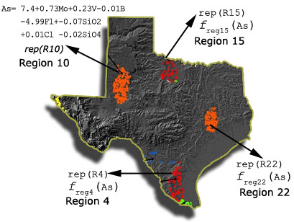
Idea Regional Regression
Our Approach: Use a separate regression function for different regions.
Problem: Need to find regions with a strong relationship between the dependent and independent variable.
Problems to be solved:
1. Discovering the Regions
2. Extracting Regional Regression Functions
3. Develop a method to select which regression function to use for a new object to be predicted.
Source: http://www2.cs.uh.edu/~ceick/kdd/CE09.pdf

Slide 2
Regional Knowledge & Coefficient Estimates
In geo-referenced dataset, most relationships only exist at regional level but not at the global level.
1st law of geography: “Everything is related to everything else but nearby things are more related than distant things” (Tobler)
Coefficient estimates in geo-referenced datasets spatially vary → we need regression methods to discover regional coefficient estimates that captures underlying structure of data.
Using human-made boundaries (zip code etc.) is not good idea since they do not reflect patterns in spatially variance.
Notes:
I would like to start with our motivation and before we even start talking about, regional regression or regression altogether, lets talk about why we need regional knowledge.
We believe spatial data or geo-referenced data contains many patterns but they are visible on regional level but not at global level.
I will give examples to support these claims in next 2 slides. But here let me give you an example that is not in the paper and I got inspired by Dr Hanrahan, our keynote speaker from yesterday. Remember he talked about Hurricane Katrina and as a person from Houston TX where 150,000 of Katrina evacuees were moved this was one of the early things we woked on. We have student data from a large school district in Houston around 7,000 students.

Slide 3
Geographically Weighted Regression (GWR)
an instance-based, local spatial statistical technique used to analyze spatial non-stationarity.
generates a separate regression function for each possible query point “online”⎯determined using a grid or kernel
a weight assigned to each observation that is based on its distance to the query point.
Reference: https://www.sciencedirect.com/topics/earth-and-planetary-sciences/geographically-weighted-regression#:~:text=Geographically%20weighted%20regression%20%28GWR%29%20is%20a%20local%20form,subsets%20of%20observations%20centered%20on%20a%20focal%20point.
Notes:
I would like to start with our motivation and before we even start talking about, regional regression or regression altogether, lets talk about why we need regional knowledge.
We believe spatial data or geo-referenced data contains many patterns but they are visible on regional level but not at global level.
I will give examples to support these claims in next 2 slides. But here let me give you an example that is not in the paper and I got inspired by Dr Hanrahan, our keynote speaker from yesterday. Remember he talked about Hurricane Katrina and as a person from Houston TX where 150,000 of Katrina evacuees were moved this was one of the early things we woked on. We have student data from a large school district in Houston around 7,000 students.

Slide 4
Motivation
Example 1: Why We Need Regional Knowledge?
Arsenic
Fluoride
Regression Result: A positive linear regression line
(Arsenic increases with increasing Fluoride concentration)
Notes:
Header – dark yellow 24 points Arial Bold
Body text – white 20 points Arial Bold, dark yellow highlights
Bullets – dark yellow
Copyright – white 12 points Arial
Size:
Height: 7.52"
Width: 10.02"
Scale: 70%
Position on slide:
Horizontal - 0"
Vertical - 0"

Slide 5
Simpon’s Paradox
Example 1: Why We Need Regional Knowledge?
Location 1
Location 2
Arsenic
Fluoride
A negative linear Regression line in both locations
(Arsenic decreases with increasing Fluoride concentration)
A reflection of Simpson’s paradox: https://en.wikipedia.org/wiki/Simpson%27s_paradox
Notes:
Header – dark yellow 24 points Arial Bold
Body text – white 20 points Arial Bold, dark yellow highlights
Bullets – dark yellow
Copyright – white 12 points Arial
Size:
Height: 7.52"
Width: 10.02"
Scale: 70%
Position on slide:
Horizontal - 0"
Vertical - 0"

Slide 6
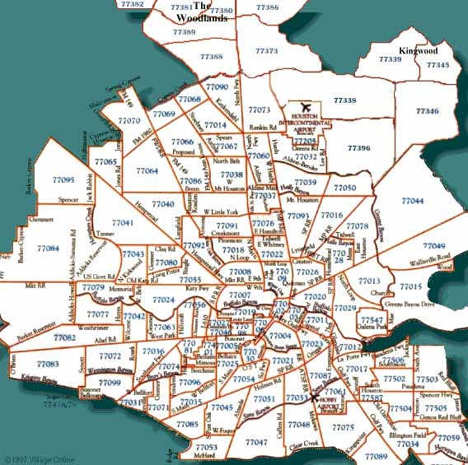
Motivation
Example 2: Houston House Price Estimate
Dependent variable: House_Price
Independent variables: noOfRooms, squareFootage, yearBuilt, havePool, attachedGarage, etc..
Notes:
Header – dark yellow 24 points Arial Bold
Body text – white 20 points Arial Bold, dark yellow highlights
Bullets – dark yellow
Copyright – white 12 points Arial
Size:
Height: 7.52"
Width: 10.02"
Scale: 70%
Position on slide:
Horizontal - 0"
Vertical - 0"

Slide 7
Motivation
Example 2: Houston House Price Estimate
Global Regression (OLS) produces the coefficient estimates, R² value, and error etc..→ a model
This model assumes all areas have same coefficients
E.g. attribute havePool has a coefficient of +9,000
(~having a pool adds $9,000 to a house price)
In reality this changes. A house of $100K and a house of $500K or different zip codes or locations.
Having a pool in a house in luxury areas is very different (~$40K) than having a pool in a house in Suburbs(~$5K).

Slide 8
Motivation
Example 2: Houston House Price Estimate
Solution: To apply local regression to each zip code
produces 50+ sets of parameter estimates
it captures spatial variations in the relationship better than global model
But it is very naïve and has problems
there is spatial variation within zip codes
assumes discontinuity but most spatial patterns are continuous and they do not stop & start at the border.

Slide 9
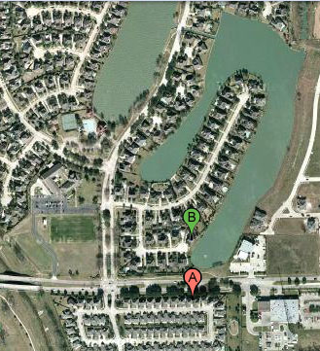
Example
Example 2: Houston House Price Estimate
$350,000
$180,000
Houses A, B have very similar characteristics
OLS produces single parameter estimates for predictor variables like noOfRooms, squareFootage, yearBuilt, etc
Notes:
Header – dark yellow 24 points Arial Bold
Body text – white 20 points Arial Bold, dark yellow highlights
Bullets – dark yellow
Copyright – white 12 points Arial
Size:
Height: 7.52"
Width: 10.02"
Scale: 70%
Position on slide:
Horizontal - 0"
Vertical - 0"

Slide 10
Example 2: Houston House Price Estimate
If we use zip code as regions, they are in same region
If we use a grid structure
They are in different regions but some houses similar to B (lake view) are in same region with A and this will effect coefficient estimate
More importantly, the house around U-shape lake show similar pattern and should be in the same region, we miss important information.
Notes:
Header – dark yellow 24 points Arial Bold
Body text – white 20 points Arial Bold, dark yellow highlights
Bullets – dark yellow
Copyright – white 12 points Arial
Size:
Height: 7.52"
Width: 10.02"
Scale: 70%
Position on slide:
Horizontal - 0"
Vertical - 0"

